Slide 1
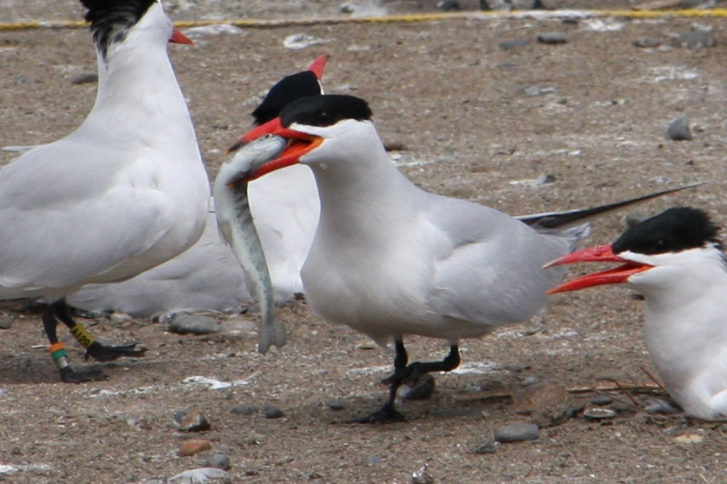



2015 Inland Avian Predation Rates
2015 Preliminary Findings

Slide 2
Acknowledgements
Co-authors
Ken Collis, Dan Roby, Don Lyons, Brad Cramer, Quinn Payton, Pete Loschl, Tim Lawes, Elizabeth Hanwacker, and John Mulligan
Collaborators
U.S. Bureau of Reclamation (Mike Lesky, Ann Haynes)
U.S. Army Corps (David Trachtenbarg)
Chelan County PUD (Lance Keller, Steve Hemstrom)
U.S. Fish & Wildlife Service (Lamont Glass)
Funding
Grant County PUD (Curt Dotson) via the Priest Rapids Coordinating Committee

Slide 3
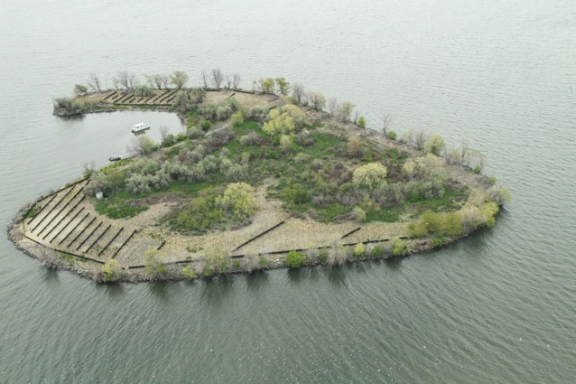
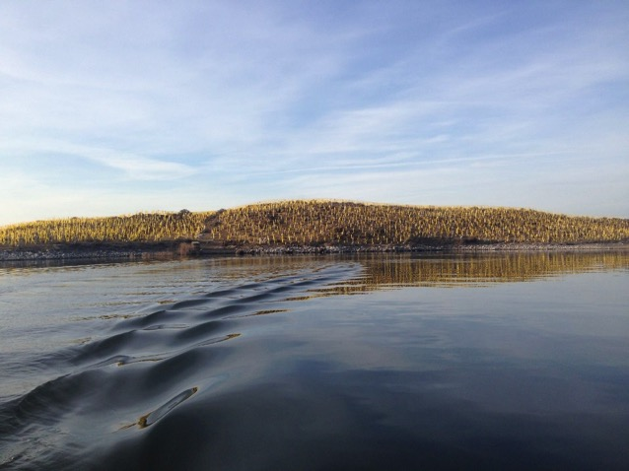
Objectives
Determine changes in predation rates on salmonid smolts by Caspian terns in relation to management activities on Goose and Crescent islands.
Determine changes in predation rates on salmonid smolts by un-managed tern colonies in the Columbia Plateau region.
Determine predation rates at other piscivorous waterbird colonies in the Columbia Plateau region.

Slide 4
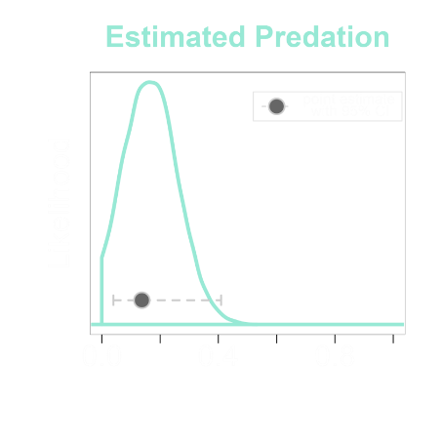
Methods
Same general tag collection and analytical frameworks as PIT tag predation research in the Columbia River estuary
  Electronic tag recovery
  Use of detection and deposition probabilities
  Predation probabilities via Bayesian analysis
Availability of tagged fish was based on the nearest upstream dam with adequate PIT interrogations
  McNary Dam (Columbia River)
  Lower Monumental Dam (Snake River)
  Rock Island Dam (middle Columbia River)

Slide 5
2015 Rock Island Dam PIT-tagging
Additional tagging of ESA-listed species needed to achieve an adequate sample of fish
Representative sampling scheme
  Abundance and run-timing
  Length, condition, and rear-type
PIT-tagged smolts from 12 April to 11 June, 2015
7,069 steelhead (5,105 hatchery, 1,964 wild)
5,763 yearling Chinook (5,376 hatchery, 387 wild)

Slide 6
Tern Colony Scanning Efforts in 2015
Nesting Locations (Rkm) | Colony | 2015 MY Smolt Tags ¹
Twinning Island (Banks Lake) | CATE | 585
Goose Island (Potholes Reservoir) | CATE | -
Crescent Island (Rkm 510) | CATE | -
Blalock Islands (Rkm 440) | CATE | 3,830
Total |  | 4,415
¹ Raw numbers of tags, with no adjustment for PIT detection or deposition probabilities

Slide 7
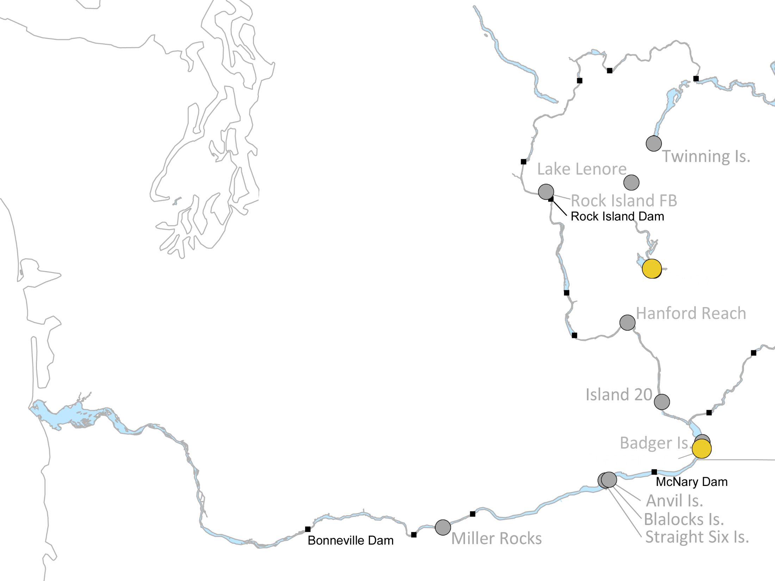
Predation Rates at Managed Tern Colonies in 2015

Slide 8
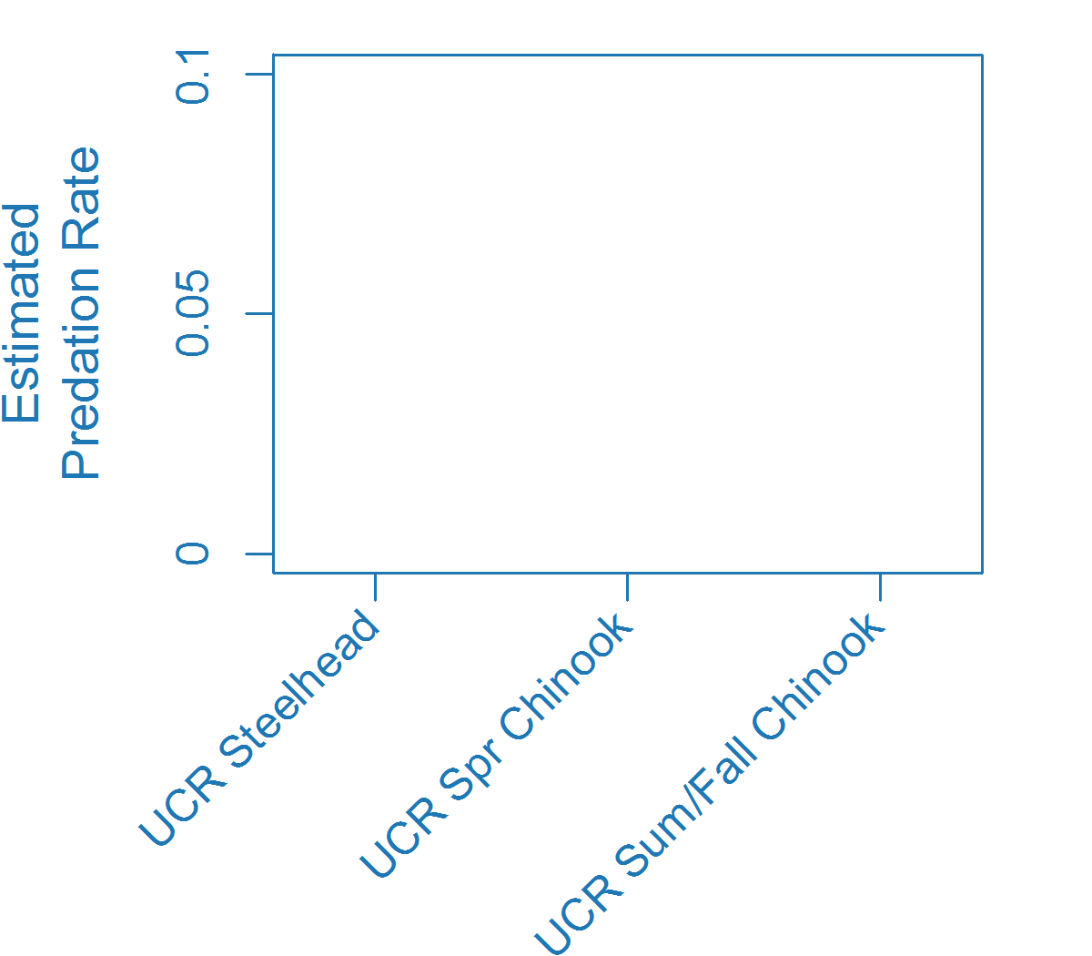
Predation Rates at Managed Tern Colonies in 2015
Goose Island (2 pairs; 39 initiated nests)
*No tag recovery conducted, estimate based on the number of initiated nests

Slide 9
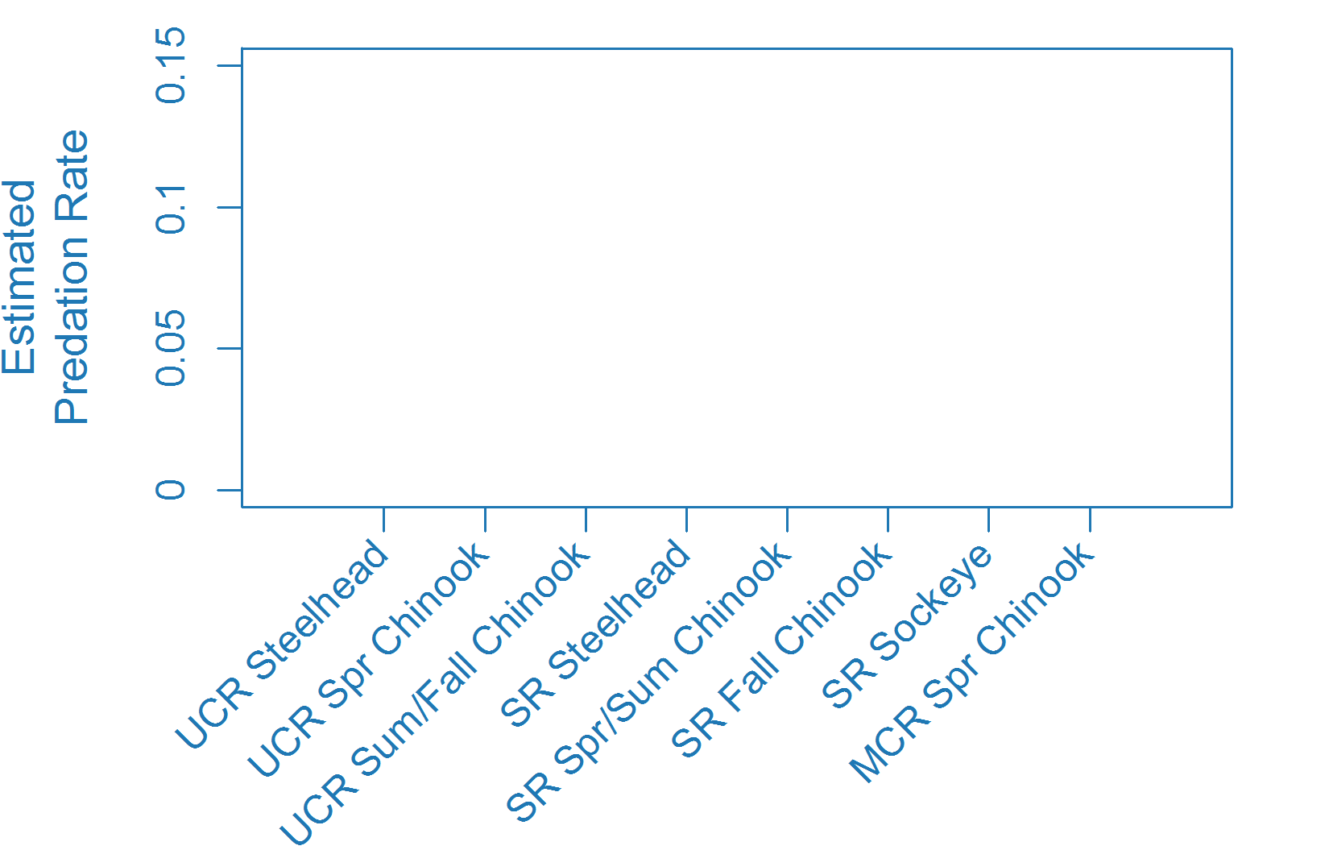
Predation Rates at Managed Tern Colonies in 2015
Crescent Island (0 pairs)
*No tag recovery conducted, estimate based on the number of initiated nests

Slide 10
Comparison of Caspian Tern Predation Rates on Steelhead Smolts
Managed Tern Colonies
Colony | 2007-2013 | 2014 (Phase I) | 2015 (Phase II)
 | Upper Columbia River Steelhead
Goose Island | 15.7% (14.1-18.9%) | 2.9% (1.9-5.1%) | {1.5%} *
Crescent Island | 2.3% (2.0-2.7%) | 3.4% (2.5-4.8%) | {< 0.1%} *
 | Snake River Steelhead
Crescent Island | 3.8% (3.4-4.6%) | 4.7% (3.7-6.9%) | {< 0.1%} *
*No tag recovery conducted, estimate based on the number of initiated nests

Slide 11
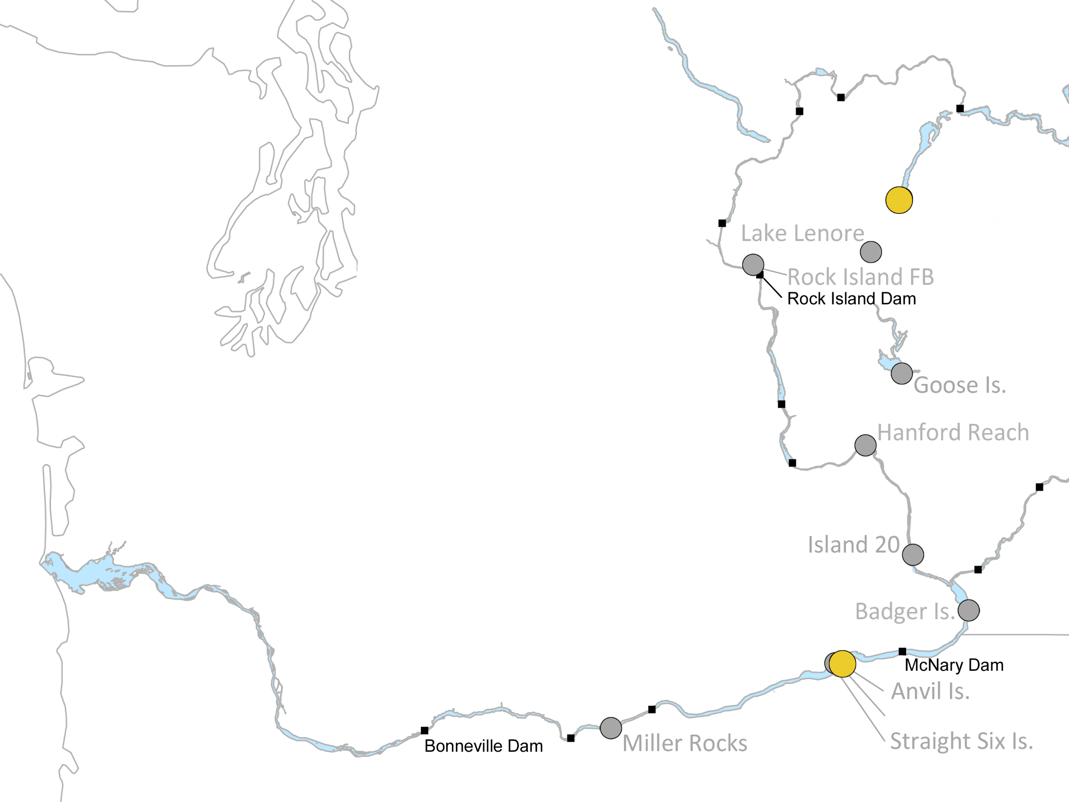
Predation Rates at Unmanaged Tern Colonies in 2015
Notes:
Steelhead predation rates was 2.6% in 2015

Slide 12
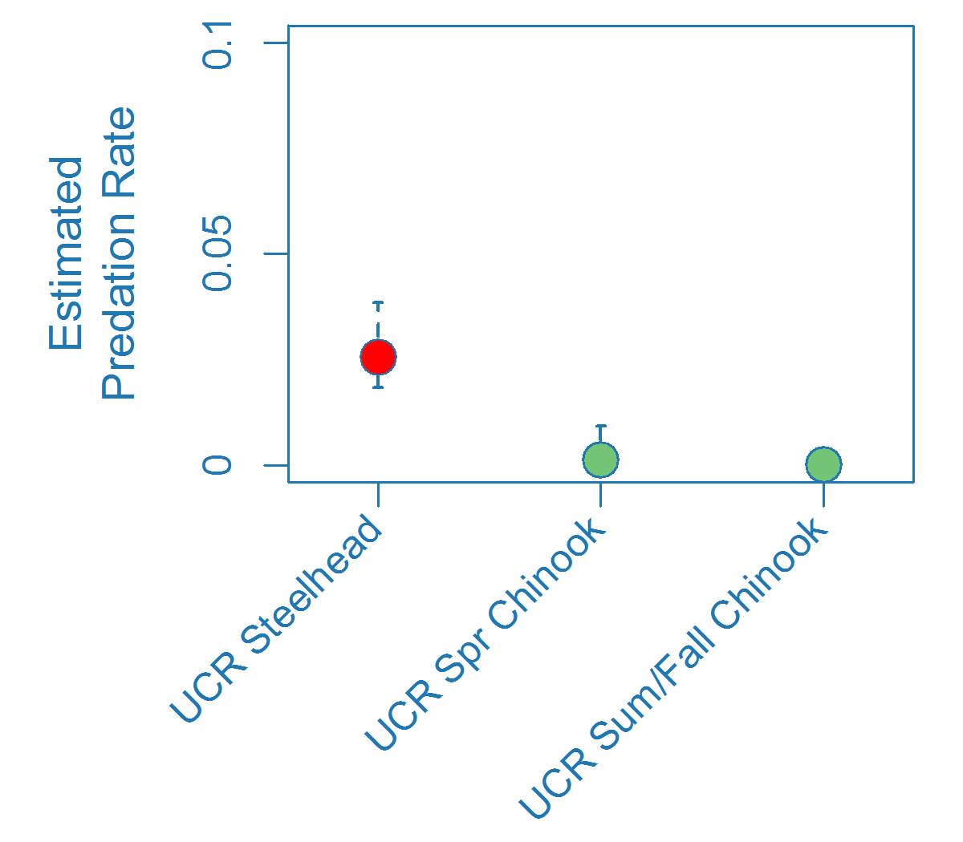
Predation Rates at Unmanaged Tern Colonies in 2015
Twinning Island (64 pairs)
Notes:
Steelhead predation rates was 2.6% in 2015

Slide 13
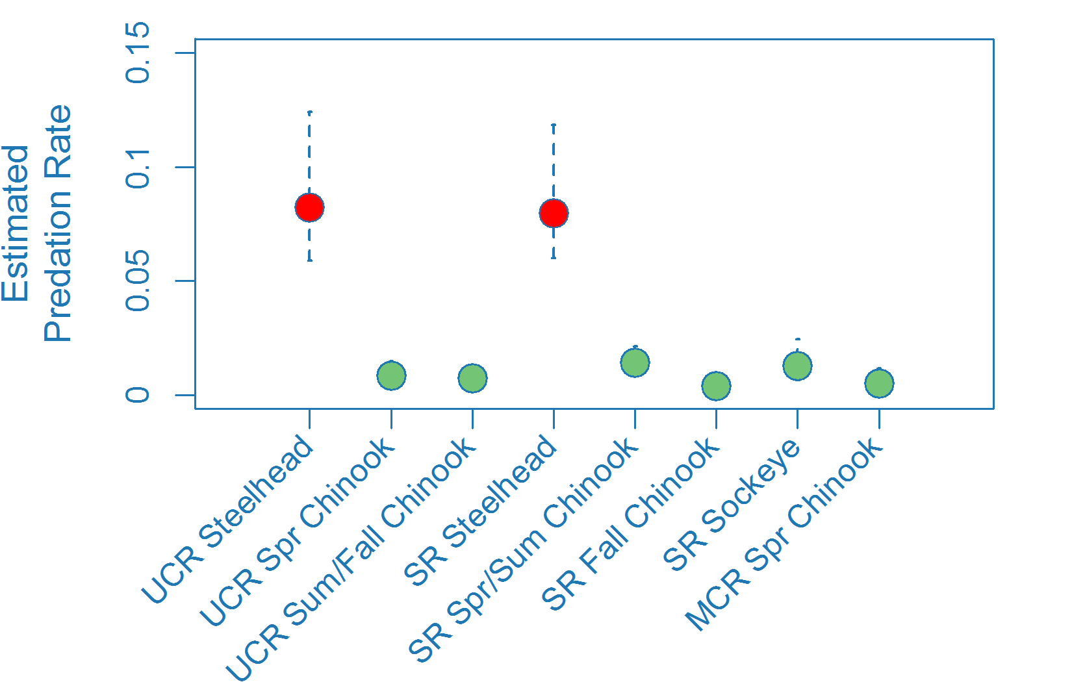
Predation Rates at Unmanaged Tern Colonies in 2015
Blalock Islands (677 pairs)
Notes:
Predation rates were 8.0% and 8.2% for SR and UCR steelhead, respectively. Estimate for sockeye (1.4%) and SR S/S Chinook (1.3%) were elevated but below threshold.

Slide 14
Comparison of Caspian Tern Predation Rates on Steelhead Smolts
Unmanaged Tern Colonies
Colony | 2007-2013 | 2014 (Phase I) | 2015 (Phase II)
 | Upper Columbia River Steelhead
Twinning Island | 0.1% (<0.1-0.3%) | 1.1% (0.4-2.7%) | 2.6% (1.9-4.0%)
Blalock Islands | 0.6% (0.4-0.8%) | 0.6% (0.3-1.2%) | 8.2% (5.9-12.2%)
 | Snake River Steelhead
Blalock Islands | 0.6% (0.5-0.7%) | 0.4% (0.2-0.7%) | 8.0% (6.0-11.8%)
Notes:
Allen will complete

Slide 15
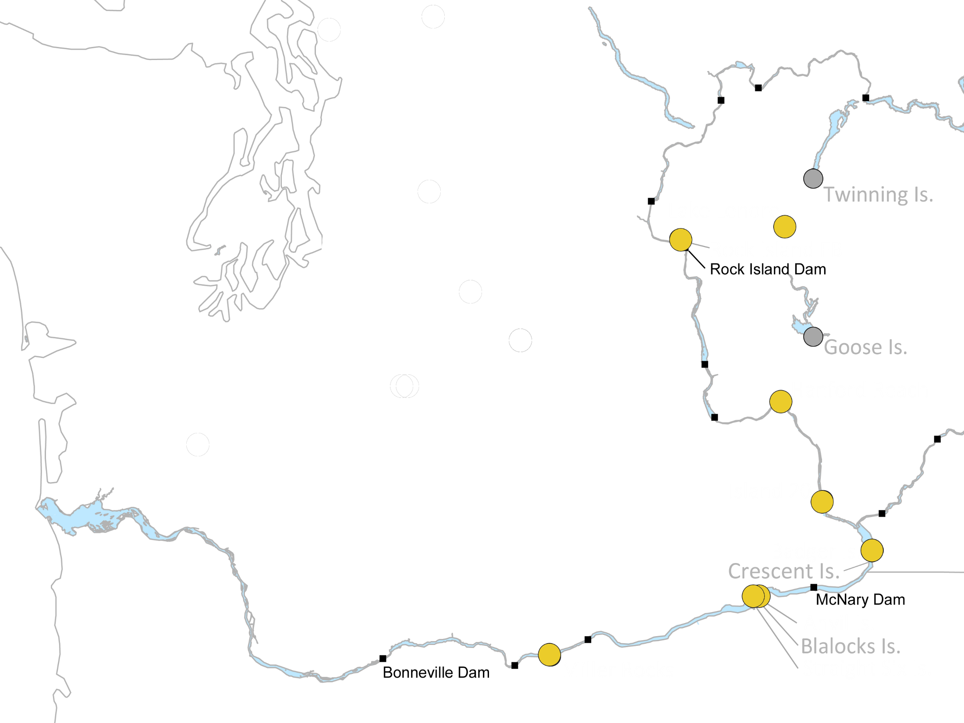
Other Avian Predator Species
Colony Sizes (number of adults)
Location | Species | 2014 | 2015
Island 20 | Gulls | 14,475 | 16,558
Badger Is. |  | 0 | 3,740
Crescent Is. |  | 6,404 | 0
Anvil Is. |  | 4,454 | 5,915
Straight Six Is. |  | 1,566 | 1,457
Miller Rocks
 |  | 4,132 | 4,433
Badger | AWPE | 2,447 | 3,267
Lake Lenore | DCCO* | 5 | 39
Rock Island FB |  | 8 | 11
Hanford Reach | DCCO*, GBHE* | 6, NA | 25, 6
*indicates number of pairs

Slide 16
Other Avian Colony Scanning Efforts in 2015
Nesting Locations (Rkm) | Colony | 2015 MY Smolt Tags ¹
Rock Island Forebay (Rkm 730)* | Mixed | 113
Lenore Island (Lenore Lake) | Mixed | 1
Hanford Reach Islands (Rkm 582-597) | DCCO | 136
 | GBHE | 27
Island 20 (Rkm 549) | Gulls | 538
Badger Island (Rkm 512) | AWPE | 374
 | Gulls | 443
 | Mixed | 408
Anvil Island/Blalocks (Rkm 439) | Gulls | 433
Straight Six Island/Blalocks (Rkm 439) | Gulls | 41
Miller Rocks (Rkm 331 ) | Gulls | 1,902
Total |  | 4,416
¹ Raw numbers of tags, with no adjustment for PIT detection or deposition probabilities
*Data courtesy of Chelan County PUD scanning efforts
Notes:
Of the other colonies, the majority of tags (ca. 70%) were found gull colonies on Island 20, Badger, and Miller Rocks,

Slide 17
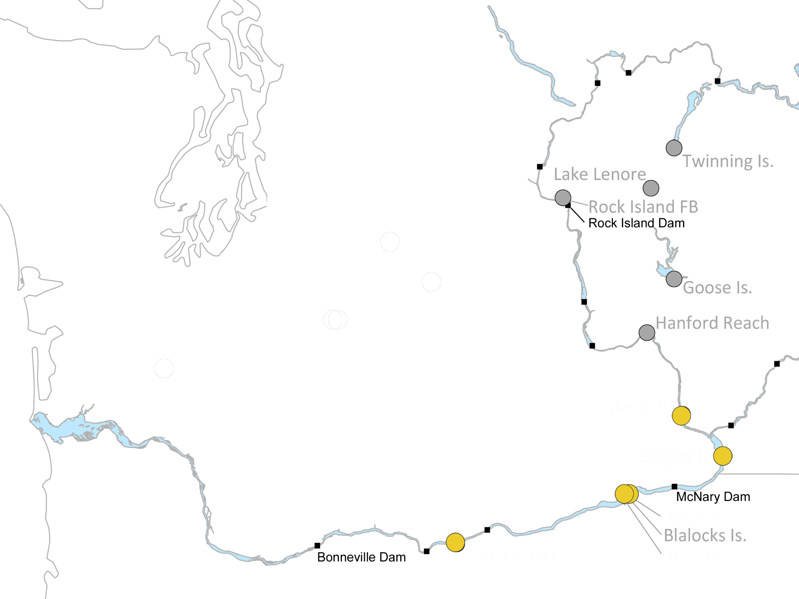
Predation by Gull Colonies in 2015
Colony | SR Sockeye | SR Spr/Su Chin | UCR Spr Chin | SR Fall Chin | SR Sthd | UCR Sthd
Island 20 | 1.0% (0.1-3.6) | 0.3% (0.1-0.8) | 0.6% (<0.1-3.7) | 0.1% (<0.1-0.8) | 2.4% (1.1-4.5) | 7.9% (5.3-12.0)
Badger Is. | 0.9% (0.1-3.2) | <0.1% | 0.5% (<0.1-3.3) | 0.1% (<0.1-0.7) | 2.1% (1.0-4.0) | 4.1% (2.6-6.4)
Anvil Is. | 1.1% (0.2-3.2) | 0.1% (<0.1-0.3) | 0.5% (0.1-1.3) | 0.6% (0.2-1.5) | 2.4% (1.4-4.0) | 6.1% (3.4-10.5)
St. Six Is. | 0.2% (<0.1-1.6) | 0.1% (<0.1-0.2) | 0.1% (<0.1-0.5) | 0.1% (<0.1-0.6) | 0.2% (<0.1-0.6) | 0.6% (0.1-2.0)
Miller Rock Is. | 7.4% (4.1-13.1) | 1.7% (1.1-2.6) | 3.5% (2.1-6.0) | 2.6% (1.4-4.6) | 9.7% (6.6-14.6) | 13.2% (8.3-21.1)

Slide 18
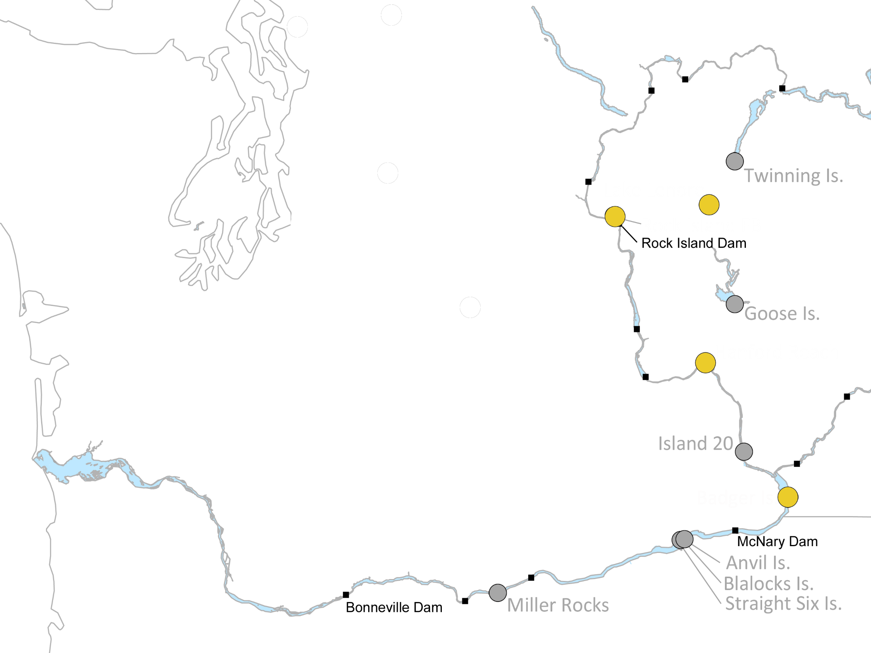
Predation by AWPE/DCCO/MIX Colonies in 2015
Colony | SR Sockeye | SR Spr/Su Chin | UCR Spr Chin | SR Fall Chin | SR Sthd | UCR Sthd
Lenore L. Mix* | <0.1% | <0.1% | <0.1% | <0.1% | <0.1% | <0.1%
Rock Is. Mix* | <0.1% | <0.1% | 0.1% (<0.1-0.4%) | <0.1% | <0.1% | <0.1%
Hanford DCCO | <0.1% | <0.1% | 0.4% (<0.1-1.5%) | <0.1% | <0.1% | 0.2% (0.1-0.5%)
Hanford GBHE* | <0.1% | 0.1% (<0.1-0.4%) | <0.1% | <0.1% | <0.1% | <0.1%
Badger Is. AWPE* | 0.1% (<0.1-0.4%) | <0.1% | 0.1% (<0.1-0.7%) | <0.1% | 0.2% (<0.1-0.4%) | 0.2% (0.1-3.0%)
Badger Is. Mix* | 0.1% (<0.1-0.4) | <0.1% | 0.1% (<0.1-0.7) | <0.1% | 0.2% (0.1-0.5) | 0.2% (0.1-0.3)
* Minimum estimate, no correction for deposition probabilities available
Notes:
Badger Island Mix (dominated by AWPE but some gulls present)

Slide 19
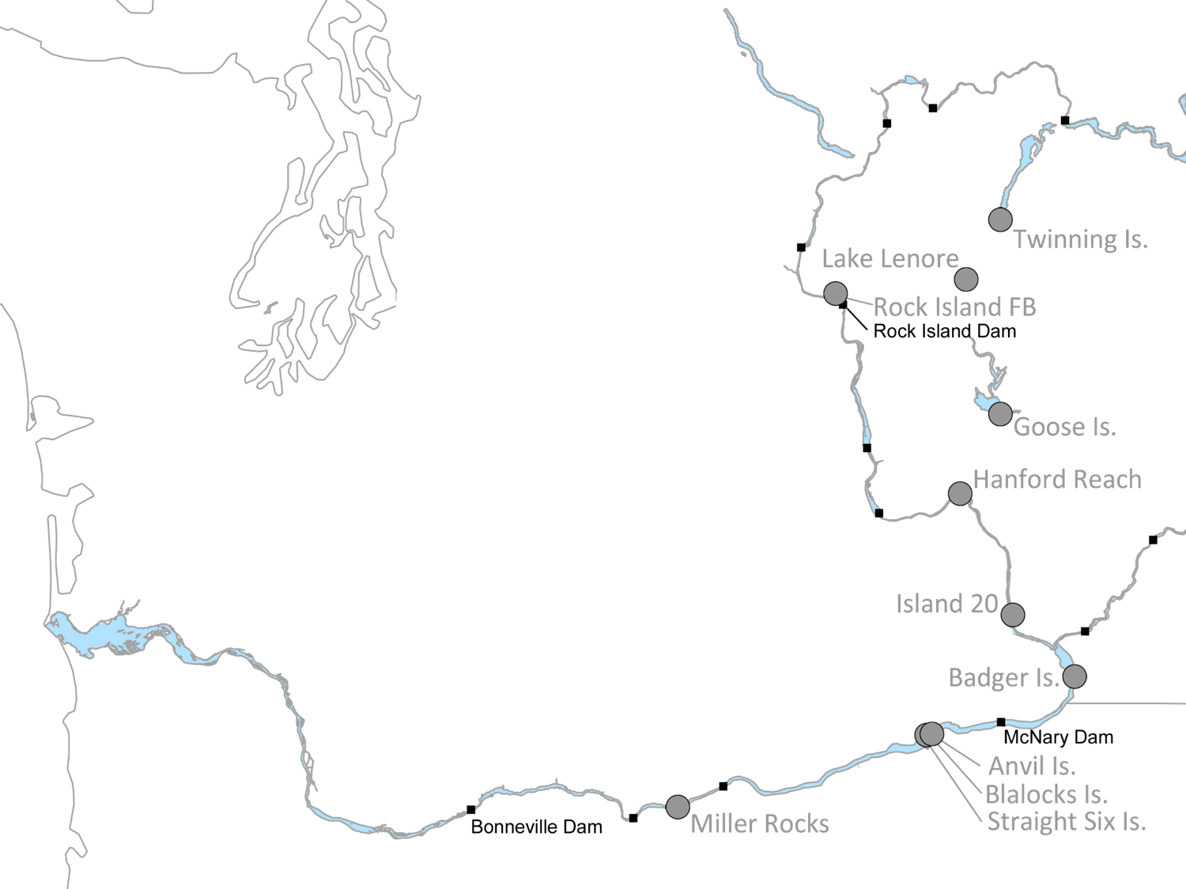
2015 Cumulative Predation Rates on UCR Steelhead
Location | Species | Predation Rate (n=7,069)
Twinning Is. | CATE | 10.3% (± 1.4%)
Blalock Islands
Island 20 | Gulls | 28.5% (± 3.2%)
Badger Is.
Anvil Is.
Straight Six Is.
Miller Rocks
Badger Is. | AWPE | 0.1% (± 0.1%)
Badger Is. | Mixed | 0.2% (± 0.1%)
Hanford Reach
Rock Island FB
Lenore Lake
Notes:
Total in 2015: 39.1% (3.5%), excluding impact from Goose Island terns
Total in 2014: ~ 24%
Total in 2008-2014: ~ 30%

Slide 20
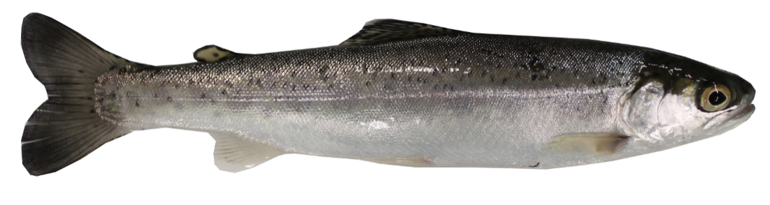
Preliminary Survival Probability Estimates
UCR Steelhead
UCR Steelhead ¹ | 2008-2013 | 2014 (Phase I) | 2015 (Phase II)
Rock Island to McNary | 0.62 (0.02) | 0.64 (0.06) | 0.73 (0.08)
McNary to Bonneville | 0.63 (0.05) | 0.67 (0.11) | 0.38 (0.06)
¹ Based on fish PIT-tagged and released at Rock Island Dam by BRNW since 2008
Notes:
Estimate (Std. Error)

Slide 21
Summary
Predation by Caspian terns nesting on managed islands was greatly reduced (Goose Is.) or eliminated (Crescent Is.) in 2015
Increased predation from terns nesting at nearby unmanaged tern colonies (Twinning, Blalocks) offset survival benefits from managed tern colonies in 2015
Impacts of other avian colonies and species, particularly gulls, on tagged smolts in the Columbia River were substantial in 2015; some of the highest ever recorded
Some evidence of increased survival of PIT-tagged UCR steelhead between RIS and McNary Dam but decreased survival below McNary Dam in 2015

Slide 22
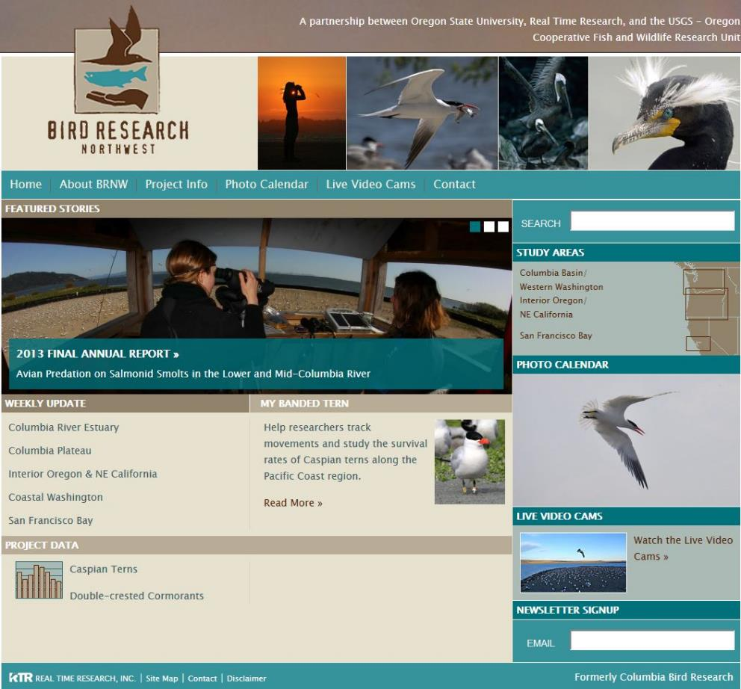
www.birdresearchnw.org

Slide 23
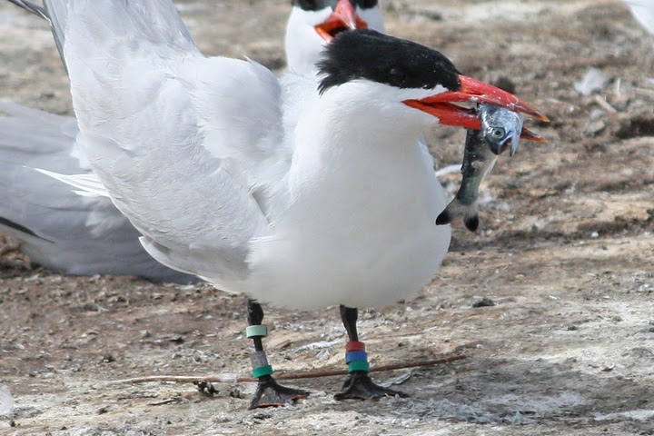
Backup Slides

Slide 24
2015 Rock Island PIT-tagging
Abundance and run-timing

Slide 25
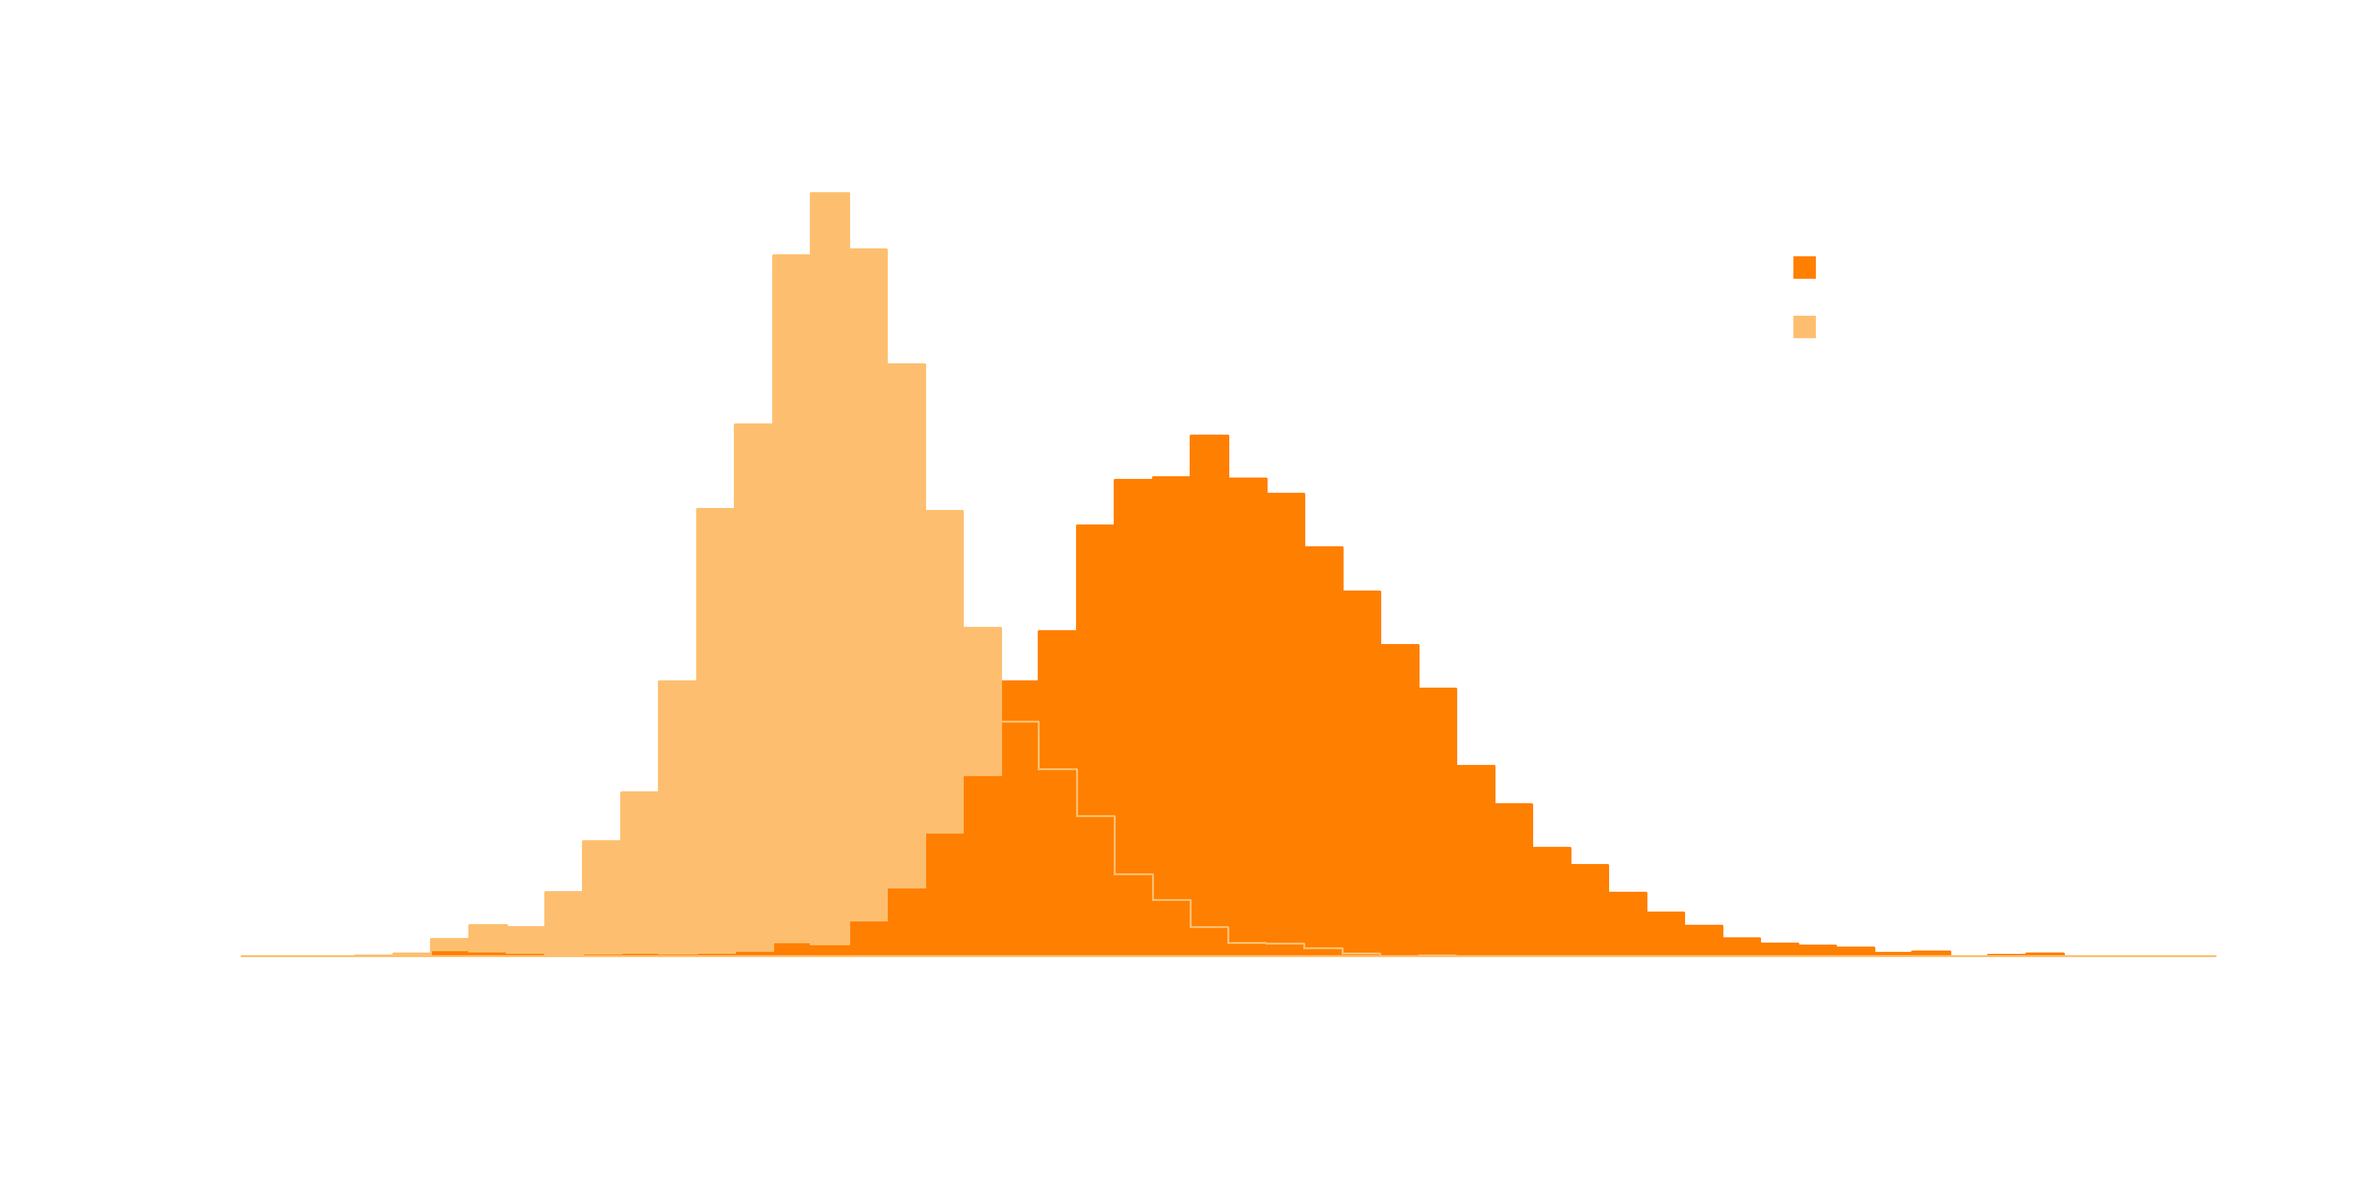
2015 Rock Island PIT-tagging
Fish Length

Slide 26
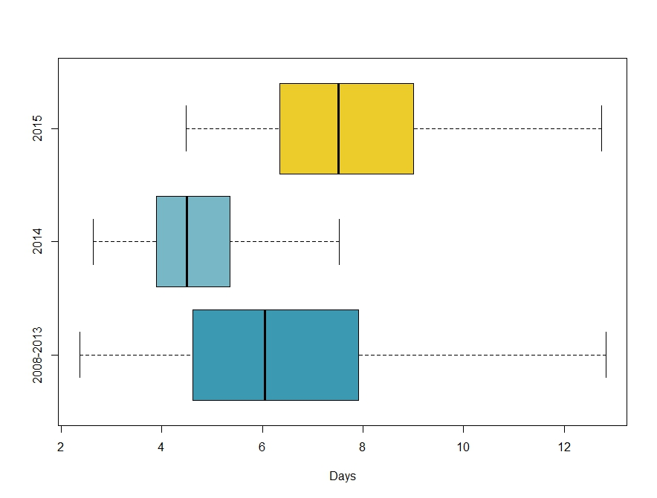
2015 Rock Island Dam Steelhead
Travel Times to McNary

Slide 27
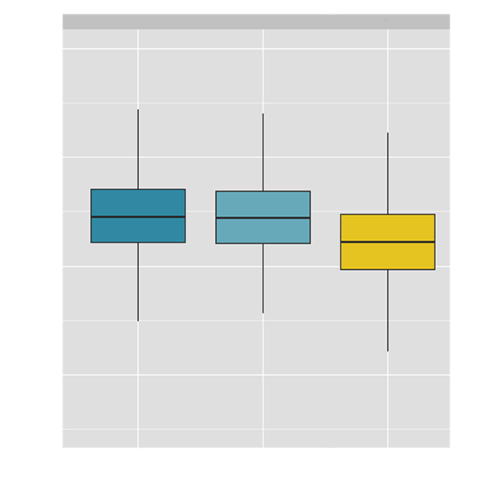
2015 Rock Island Dam Steelhead
Condition
Fulton’s Condition Index
K=100,000(W/L³)
External Condition
Photo analysis

Slide 28
2015 Cumulative Predation Rates on UCR Spring Chinook
Location | Species | Predation Rate (n=5,763)
Twinning Is. | CATE | 1.3% (± 0.3%)
Blalock Islands
Island 20 | Gulls | 7.8% (± 1.5%)
Badger Is.
Anvil Is.
Straight Six Is.
Miller Rocks
Badger Is. | AWPE | 0.1% (± 0.1%)
Badger Is. | Mix | 0.4% (± 0.3%)
Hanford Reach
Rock Island FB
Lenore Lake
Notes:
Total: 9.4% (1.6%)

Slide 29
Summary of Avian Loafing/Roosting Sites Scanning Efforts in 2015
Loafing/Roosting Sites (Rkm) | Avian Species | 2015 MY Smolts
Mud Island – Desert Aire (Rkm 645) | Mixed | 147
Cabin Island (Rkm 641) | Mixed | 32
Marsh Unit 1 (Columbia NWR) | Mixed | 96
Hanford R. Islands (Rkm 582-597) | Mixed | 35
Blalock Islands (Rkm 440) | Mixed | 202
Total |  | 512
Raw numbers of tags, with no adjustment for PIT detection or deposition probabilities

